Slide 1

Wisconsin
Odyssey of the Mind
Coaches’ Training
Based on The “Unofficial” On-Line Coaches’ Training
by T.Perkins (VT), J. Otte (NY), & S. Riggs (TX)

Slide 2
Before we get started…
This online coaches training is intended to be used as a brief introduction to the Odyssey of the Mind™ Creative Problem-Solving program. It is not an official information. The BEST source of information is the current-year Program Guide.
There are many other resources available to coaches, some are referenced here as hyperlinks. Others you will have to locate on your own.
Refer to pages in the Program Guide where you can find more information.
This training can in no way fully substitute for a live Coaches’ Training with an Odyssey of the Mind trainer. It is intended only to help get you started if you are unable to attend a training session, or if training is not available in your area.

Slide 3
What is Odyssey of the Mind?
OotM is an international creative problem-solving program based upon the idea that creativity is a skill that can be taught and further developed with practice.
Goal is to develop independent and divergent-thinking abilities (think outside the box, take the path less traveled) through a challenging, fun learning process.
Team-effort, based loosely upon a sports model.
Problem solutions are demonstrated at a tournament. All teams presenting solutions are WINNERS!
Participants compete within 4 age divisions, kindergarten through college.
Develops real-life communication and brainstorming skills, and rewards creativity and “calculated risk-taking” while solving complex problems.

Slide 4
History of Odyssey of the Mind
The program was started by a NJ College Educator, Dr. C. Samuel Micklus (Dr. Sam). Dr. Sam challenged Industrial Design students to solve problems in unusual and creative ways. At the end of the semester, students competed with their solutions.
The Olympics of the Mind program began in 1978 by expanding to NJ High Schools.
Now known as Odyssey of the Mind, new problems are written each year.
Creative Competitions, Inc. was formed to develop the problems and administer the program at the national, and later, at the international level.

Slide 5
Wisconsin Odyssey of the Mind
Odyssey of the Mind started in WI in 1983
Creativity Unlimited in Wisconsin (CUW) is a non-profit 501(c)(3) organization that provides the Odyssey of the Mind program in WI.
Creativity Unlimited in Wisconsin is an affiliate of Creative Opportunities Unlimited, a 501(c)(3) non-profit organization.
ALL Volunteer run

Slide 6
Program Structure—Memberships
A membership can belong to: a school, club, church, library,
community group, home school, etc...
A membership in Odyssey of the Mind costs $135. The application can be found here.
The Membership Coordinator receives the problems from the international organization, and information from the Wisconsin Odyssey of the Mind organization.
State team registration fee
Supply one trained judge for the tournament. Teams who do not supply a tournament official will receive a 25 pt spirit of the problem penalty.

Slide 7
Memberships & Teams
A membership is allowed to field one team per
division per Long-Term problem AND an unlimited number of Primary teams. Thus:
  K-5 School: usually up to 5 teams + unlimited Primary teams
  K-8 School: usually up to 10 teams + unlimited Primary teams
  K-12 School: usually up to 15 teams + unlimited Primary teams
  5-8 School: usually up to 10 teams
  9-12 School: usually up to 5 teams
Additional memberships allow more teams to participate in the same problem (Team A, Team B).

Slide 8
Program Structure—Teams
Teams of 5-7 students participate in their choice of the Long-Term problems for that year and one Spontaneous problem.
  All team members may participate in the LT presentation.
  A maximum of 7 “minds” can work on the problem. (In other words, No Outside Assistance!)
  Only 5 team members may participate in Spontaneous (team can choose which 5). Additional team members may observe.
Teams participate within divisions. This is based upon the grade level of the oldest team member.
  Primary (usually K-2)
  Div I (every team member in K-5th grade)
  Div II (at least one team member in 6th-8th grade)
  Div III (at least one team member in 9th-12th grade)
  Div IV (all members with high school diploma and taking at least one college course)

Slide 9




The Three Components of OOTM
Long-Term (LT)
200 Points
Specific Rules
Open-Ended
All Solutions Presented
in Skit Form (8-min)
Style
50 Points
Elaborated on
Long-Term
Pizzazz, Sparkle, Polish
Team Chosen Elements
Spontaneous
100 Points
On the Spot/Anything Goes
3 Types: Verbal, Hands-on, Hybrid
Long-Term + Style + Spontaneous = Total Score
Raw Scores are “adjusted” so the team with highest raw score (for each component) receives the full possible score (200, 100, or 50 pts for the three components). Other team scores adjusted proportionally.

Slide 10
Spontaneous Problem
Spontaneous problems come in three types:
  Verbal – problems requiring verbal responses
  Hands-on – problems requiring manipulation of materials
  Verbal/Hands-on (Hybrid) – problems with both verbal and hands on components
PRACTICE… PRACTICE … PRACTICE !
  Practice all three types (you don’t know what you’ll get for competition).
  Do at least 3 spontaneous problems each time the team meets.
  Critique the teams performance (Coaches: Hints are fine here!)
  Have each team member
  specialize in something.
  Fall back plans ….
  Brainstorm ways to
  get “unstuck”
Spontaneous Resources
Odyssey of the Mind
Virginia's Archive of Problems
CTOM Spontaneous Zone
Georgia Odyssey
Tennessee Spontaneous Problems

Slide 11
The Long-Term Problems
  Six new Long-Term problems each year. The Problem Synopses briefly describe them.
    Vehicle – Problem 1
    Technical – Problem 2
    Classics – Problem 3
    Structure – Problem 4
    Theatrical – Problem 5
    Primary – Non-competitive (K-2) to learn the process
  There is a cost limit to each problem (usually ~$125-$145)
    Solutions cannot be “bought”
    Only the materials used in competition included in the cost
    Duct tape & cardboard, lawn-sale value, scavenging
    Some “standard” and safety items are exempt from cost, as listed in Program Guide.
Creativity Unlimited of Wisconsin

Slide 12
The Long-Term Problems Continued …
All have a theme with a skit and are performed in 8 minutes
When teams start to work on the long term problem varies. Some start in November and others in January to present their solutions at the Wisconsin State Tournament.
Participation requires a commitment from:
  Team members
  Coaches
  Membership Coordinators
  Volunteer Judges and Officials

Slide 13
What’s needed to get started with our Long-Term problem?
There are 3 major information sources that are required to coach an Odyssey of the Mind team
  Program Guide (available on the official website or through your membership coordinator)
  Long-Term Problem (available from your membership coordinator)
  Clarifications general and team (available on the web, through your coordinator, or through your State Association, released throughout the season)
In general . . . If it doesn’t say that you can’t do it . . . Then, you CAN!

Slide 14

HOME PAGE
National Membership Registration
General Clarifications
Enter Member Area

Slide 15
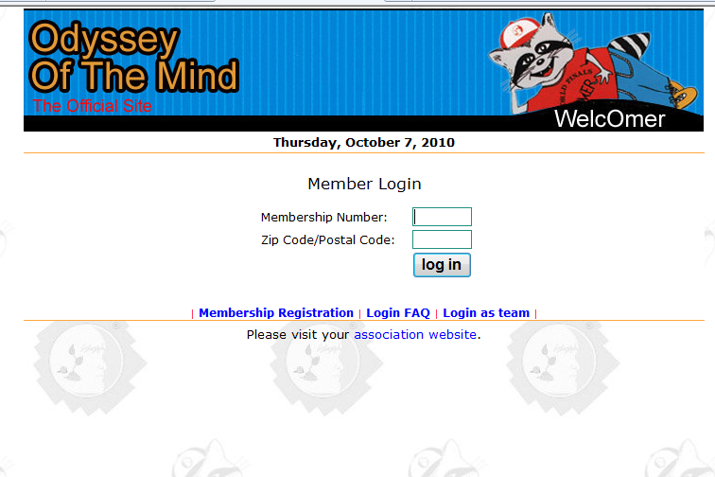
Entering Member Area
Enter Membership # & zip code on record to begin team registration

Slide 16
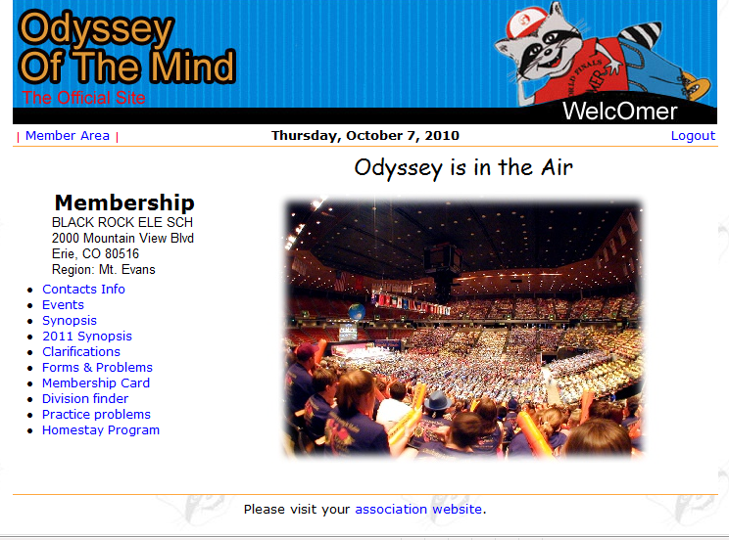
Member Area

Slide 17
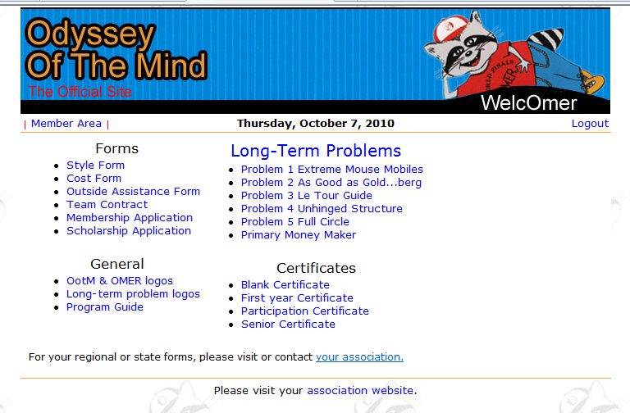
Member Area

Slide 18
Do it with Style!
Style is the place for the team to
showcase their strengths and talents.
Style is the elaboration of the Long-Term Problem. It is how the team shows the judges what they are particularly excited about or proud of. Style is presented during their Long-Term Problem Solution performance. What makes this performance really shine?
  Artistic design, music, songs, choreography
  Construction, creative use of materials
  Humor, rhyme
  Overall effect (theme)
5 Categories (some mandatory, some team-choice, overall)
  Choose carefully and BE SPECIFIC!

Slide 19
SCORING
Raw long term up to 200 points
  Weight held for structure can be much higher
Raw style up to 50 points
Spontaneous can be any value
Long term is scaled to 200
Style is scaled to 50
Spontaneous scaled to 100
Sum of scaled scores minus penalty is the calculated score

Slide 20
Penalties
Penalties are designed to prevent teams from bending or breaking the rules, creating a safety hazard, interfering with other teams, delaying competition or misbehaving.
  Spirit of the Problem – Aimed at preventing teams from circumventing the intention of the rules in either Long-Term or Spontaneous (-1 to -100 pts).
  Unsportsmanlike Conduct – For intentional (or unintentional) impairing another team’s solution, disruptive behavior, inappropriate language, damage to facilities (-1 to -100 pts).
  Outside Assistance – If team receives help from anyone. This applies to audience as well. Thus teams shouldn’t encourage audience participation (-1 to -100 points).
  Incorrect/Missing Membership Sign – -1 to -15 points.
  Over Cost Limit – Materials over cost limit (-1 to -100 points)
  Over Time Limit – For each 10 sec. or fraction (-5 points)

Slide 21
Outside Assistance (OA)
OOTM is Hands-On for Kids,
but Hands-Off for Adults!
One of the most important parts of OOTM is that the team must conceive, design, construct, and perform their own ideas. Help external to the team is termed “Outside Assistance”.
  The solution is the team’s design, their work, their performance, and their score. The team is responsible for what the result, not the coach.
It’s important that parents know OA rules too! Scenarios for discussion can be found here.
OUTSIDE
ASSISTANCE

Slide 22
Is It OA or Not OA?
Outside Assistance
A team decides it will center its skit on a CELL theme. The coach gives the team members a homework assignment to come up with as many words as possible that contain the word CELL, such as cellophane, cellular phone, etc.
Answer: Not OA – Although the coach should not give the team any examples, the assignment is one of the types of things the coach should do to help the team develop its creativity.
Rationale: It is not OA for a coach to give a homework assignment that gets the kids to think more creatively about an initial idea that they came up with.
Notes:
22

Slide 23
Is It OA or Not OA?
Outside Assistance
Kids try to assemble two boards (fourth graders) using screws and nails, but they keep falling apart. The coach screws and nails the boards together so no one gets hurt.
Answer: It is OA – An adult can tell and show the team members various ways to connect boards. He/She must not show the team one specific way to connect the boards in the team’s solution. An adult should give the team many possible ways to assemble the boards and must allow the team to determine what it will do in its solution. There is a principle that if information can be found through research, an adult can tell the team.
Rationale: It is OA for the team to ask an adult who is familiar with carpentry how to fix the problem
Notes:
23

Slide 24
Is It OA or Not OA?
Outside Assistance
A Division I team is spray-painting a prop and the coach holds a team member’s hand for about 2 seconds (out of a 30-minute job).
Answer: It is OA – The coach may not help spray paint anything used in the solution. However, the coach may teach the team member how to spray paint by using something that is not part of the solution such as a scrap piece of wood.
Rationale: It is not OA for the coach to teach a team member the proper way to spray paint on a practice/scrap piece
Notes:
24

Slide 25
Is It OA or Not OA?
Outside Assistance
A coach presents the team with a simple, generic demonstration of an engineering concept that the team immediately applies to its solution (e.g. a simple demonstration of how a truss withstands lateral loads better than a frame).
Answer: It is OA. The presentation of one engineering concept represents OA in this circumstance
Rationale: The coach would have to present several options of construction and demonstrate how each fails, but the team members must draw their own conclusions.
Notes:
25

Slide 26
Is It OA or Not OA?
Outside Assistance
A goal for a team is to learn how to take a complex problem apart, test each component in a controlled manner, then reintegrate the resulting solution and validate if it performed as expected. The coach builds the jigs and the tester.
Answer: Not OA – For testers; It is OA – For jigs.
Rationale: Anyone may make a tester but only the team may make jigs because they are construction aids.
Notes:
26

Slide 27
Is It OA or Not OA?
Outside Assistance
Team members are creating the script (Div. 1) and the coach writes down what they say.
Answer: Not OA – As long as the coach writes only the team members’ words. Allowed in any division.
Rationale: It is not OA for the coach to write down what they say so that they can look at what they already have.
Notes:
27

Slide 28
Is It OA or Not OA?
Outside Assistance
In a team’s long-term performance their vehicle will mark the floor. At the beginning of the performance a parent lays down a covering to protect the floor.
Answer: It is OA. The team may have help with prop movement at any time except during the timed competition period.
Rationale: Only team members can move items out of the Staging Area
Notes:
28

Slide 29
Is It OA or Not OA?
Outside Assistance
A team is preparing for its spontaneous competition. The coach tells them whether they made a creative response or a common one. The team is given constant, direct feedback on the quality of their spontaneous solutions.
Answer: Not OA –There is no such thing as OA in Spontaneous.
Rationale: Preparing teams is one of the primary roles of the coach. It is not OA for the coach to prepare their team for spontaneous competition in that manner.
Notes:
29

Slide 30
What is the role of the coach?
Schedule (how often and where team meets)
Facilitate (helps the team stay organized)
  Determine goals and the path to reach them
  Assist team in developing a timeline for projects
  Help team read and understand the problem including scoring
  Help team keep track of tasks and deadlines
  Take notes (remind them of their previous ideas)
  Lead brainstorming sessions (without injecting ideas)
  Bring in “experts” to discuss and teach skills
Teach basic skills
Ask open-ended QUESTIONS (to help team focus)
Guide team in Spontaneous practice (practice often, variety, teach strategies)
Guide team through forms
Go-fer (take team members to store for supplies)
Organize snacks (fuel for busy minds)

Slide 31
Typical Timeline
Sep.–Nov. Membership Coordinator:
        Establish who the mail goes to (Membership Coordinator)
        Purchase membership (1 or more per school: $135 each)
        Form teams, recruit coaches
        Pay State team fee ($10 before Dec.31; $20 in Jan.; $30 late fee if after Jan.)
Nov-Jan. Coach: attend coaches training
Nov.–Mar. Team: work on solutions
Dec.-Jan. Coach: Sign-up for tournament; pay team tournament fee
Feb. 15 Coach: Deadline to register official
March Judges training dates: http://wi.odysseyofthemind.org/calendar.shtml
March Wisconsin State Tournament
May OotM World Finals

Slide 32
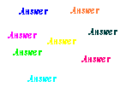
What is divergent-thinking?
Convergent Problem Solving
- For every problem, there is
just one correct answer
Divergent Problem Solving
- For many problems, there are
many correct answers
Odyssey of the Mind encourages young
people to explore many possible answers
and to be creative in finding a solution
Because there are no wrong solutions, teams are free to
take calculated risks in attempting to solving the problem
Odyssey of the Mind allows kids to use their imaginations to interpret and solve complex problems in a FUN way!

Slide 33
Teambuilding
It is important that this group comes together and functions as a team. Important decisions should be made together.
Incorporate some team-building games into each practice session, especially early in the season. This will build team trust, and teach students to work together to solve problems.
Do not allow criticism of people or their ideas. It is okay to evaluate ideas on their merits, but it must be done constructively.
Celebrate milestones, breakthroughs and accomplishments.
Once an idea is generated and discussed, it is no longer owned by the originator….it is the TEAM’S idea.

Slide 34
How to solve the problem
Step 1 – Read the Problem (then read it again!)
  Go through each section of the problem carefully.
  Figure out the requirements of the problem (and the scoring elements). Make sure each participant understands what is required
  Understand how each of the parts interact
  General ideas are OK, but don’t focus on brainstorming solutions yet
Step 2 – Brainstorm Possible Solutions
  Generate lots of ideas (keep track of them on paper, chalkboard, or whiteboard)
  Don’t evaluate ideas yet… just list them.
  Break the problem down into manageable pieces
  Encourage wild, creative solutions

Slide 35
How to solve the problem
Step 3 – SCAMPER
  Use SCAMPER and other Brainstorming techniques to come up with more ideas
  Change ideas to generate even more
Step 4 – Refine and Evaluate Ideas
  Which ideas does the team like best? Discuss and evaluate ideas, but don’t criticize
  Modify ideas to make them better.
  Select a preliminary solution.

Slide 36
How to solve the problem
Step 5 – Determine Tasks and Timeline
  What types of tasks, skills, props, contraptions, are needed?
  Who and how will they do these things?
  Determine a basic time-line for completing the solution.
  Continue to evaluate the solution and refine/revise as needed.
  Do the items decided upon fit the problem specifications?
Step 6 – Begin Construction
  Start building and writing. Evaluate new ideas as they arise.
  Test the solution. Does it work? Can it be made to work better?
  Revise/refine (continuously).

Slide 37
How to solve the problem Continued…
Step 7 – Put it Together (At least one month before tournament)
  As props and tasks are near completion, or are completed, test them out.
  Continue to refine/revise.
    Does it work?
    Is there a better way?
    Does the solution still fit the problem?
    What problems need to be fixed?
Step 8 – Finish Up and Practice
  Test things out… do they work? Revise/refine.
    Can they work better?
    What happens if something goes wrong?
    Is there a contingency plan?
  Practice the whole skit. Timing. Have them explain how they did it? Look for problem spots.

Slide 38
The First Five—Meeting 1
Meeting 1
Meet with team (and parents) to explain program and set team goals and expectations
Stress commitment to attending meetings, the tournament and responsibility of being on the team
Explain outside assistance
Review behavioral expectations
Talk about difference between “winning” and “succeeding”
Set a meeting schedule

Slide 39
The First Five—Meeting 2
Meeting 2
Incorporate team-building activity
Discuss working as a group. All ideas are valid
Review brainstorming rules (no put-downs)
Explain Spontaneous. Practice several at every meeting
Read the Long-term problem Synopses
Talk about skills and interests of team members and group

Slide 40
The First Five—Meeting 3
Meeting 3
Incorporate team-building activity
Brainstorm how group can be a successful team
Practice Spontaneous
Decide on Long-term problem. Various ways: Kids choose; Coach chooses for the team (often with younger); Kids sign up for a problem that is offered
Break problem down into parts. Brainstorm possible solutions to LT problem

Slide 41
The First Five—Meeting 4
Meeting 4
Practice Spontaneous
Read the Specific Long-term problem rules
Brainstorm LT problem solutions and skills needed to solve problem

Slide 42
The First Five—Meeting 5
Meeting 5
Continue team-building
Continue Spontaneous practice
Brainstorm list of tasks to accomplish and timeline
Assign tasks and discuss team member responsibility
Ask for help if you need it

Slide 43
Coaching Tips
Read the problem, then Re-Read the problem!
Starting Up
The Timekeeper will ask the team, “Team, are you ready?” Many (especially experienced) teams come up with a clever response.
Setup Time
Don’t neglect to figure in set-up time.
  What happens if something goes wrong during setup? Who handles what tasks during setup?
  Is it better to have a complicated setup, or a simple setup and more performance time?
  Is there something someone can do during setup to start the performance?
  Time does not stop if the team encounters a problem (except for medical emergencies).
Wrap it Up
Like the beginning, the end is important! In some (not all) problems, the team needs to signal the judges that the performance is over. Creative teams find a “creative” way.
Tell it to the Judge!
After the performance ends, the judges will talk to the team and ask them questions about their solution. This is a part of the solution. Let the team know to expect it and practice it with them.

Slide 44
Don’t forget the Membership Sign…
Don’t forget your forms!

Slide 45
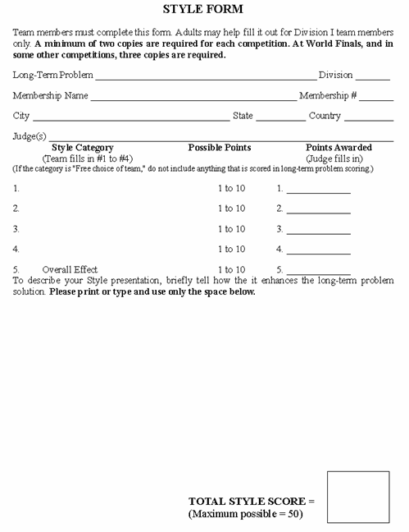
Style Form
4 copies for Staging Judge
Elaborates Long-Term problem
Relates to the solution’s theme
Team can showcase strengths
Cannot be items already scored as part of Long-Term
Categories
  Specific Scoring Elements
  Free Choice Elements
  Overall Effect
Be very specific when describing elements on form.

Slide 46

Cost Form
1 copy for Staging Judge
Must represent everything used during the LT & Style
Doesn’t include items not used during presentation
“Garage sale value” if used items
Combine value of small items
Exemptions (Program Guide p.46-48)
Acquire materials creatively, “the art of scavenging”
Cardboard, duct-tape, even “donations” all have value

Slide 47
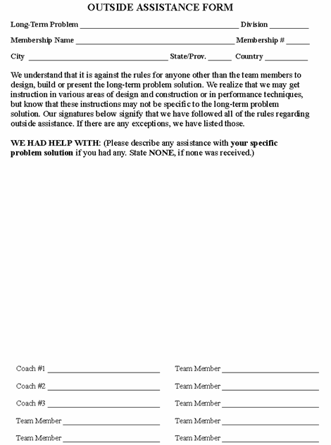
Outside Assistance (OA) Form
1 copy for Staging Judge
Only 7 members can contribute to problem solution
Coaches are facilitators
Coaches can assist Div I teams in filling out forms, but must use team’s own words
If OA did occur, list on form, may result in a penalty
Penalty is proportional to amount and type of help given

Slide 48
Team’s Required List
4 copies to the Staging Judge
Requirements that must be included on the list are found at the end of Section B. in each problem. Exception: Problem #4 does not require a list.
Hand printed or computer generated on one side of 1 or 2 sheets of 3 ½ X 11 inch paper.

Slide 49
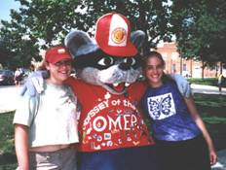
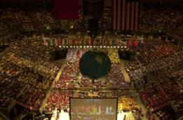
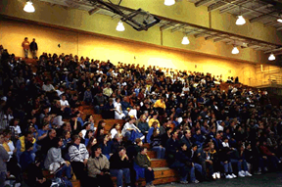
Tournaments
Odyssey of the Mind tournaments are held in the spring of
each year around the world at various levels.
Creativity Unlimited of Wisconsin hosts the WI State Tournament.
Odyssey of the Mind hosts the World Finals!
These tournaments provide an opportunity for teams to present their creative solutions, to be judged against the problem criteria and to see how others solved the same problem!
Although the event is a competition, it is meant to be a time for the teams to be rewarded, meet others and to have FUN!
Creativity Unlimited of Wisconsin

Slide 50

Tournaments Continued…
Every team presenting
a solution is a winner!
However, because a competition model is used, teams are judged for how well and how creatively they satisfy the problem criteria. Only one team per division is awarded 1st Place overall for each LT Problem.
1st Place teams and Ranatra Fusca recipients are invited to attend the World Finals (the policies of your school or local association may vary).

Slide 51
What do coaches do on tournament day?
Pick up your team’s registration packet. Read through it and determine your schedule for the day.
Get your team to the Long Term Staging Area about 15 min
prior to their scheduled LT competition time.
Get your team to the Spontaneous Holding Area about 15 min prior to their scheduled Spontaneous competition time.
  (Parents and other supporters should not accompany the team.)
Enjoy your team…
Enjoy other teams…
Enjoy the day…
Start planning for next year…

Slide 52
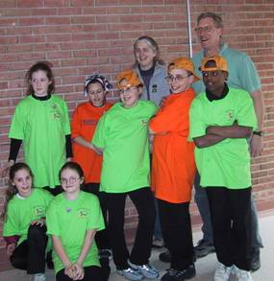
Odyssey of the Mind Recognition
OMER Award
Recognizes teams or individuals who demonstrate outstanding sportsmanship, exemplary behavior, and exceptional talent.
Ranatra Fusca
Presented to teams or individuals who exhibit exceptional creativity, either through some aspect of their problem solution, or an extraordinary idea beyond the problem solution.
Tournament Placements are determined by total score (see slide 16).
Teams tie if there is less than a 1 point difference.

Slide 53
More Resources
Other coaches
WI website & local association
  http://wi.odysseyofthemind.org/
Other state websites
International program headquarters
Problem procedures (usually in late Feb. newsletter)

Slide 54
Contact Us
For more information, or to register:
Wisconsin site: http://wi.odysseyofthemind.org
International site: http://www.odysseyofthemind.com
  OOTM Headquarters
  c/o Creative Competitions, Inc.
  406 Ganttown Road
  Sewell, NJ 08080
  Tel: (856) 256-2797
  Fax: (856) 256-2798
  Email: info@odysseyofthemind.org

Slide 55

Odyssey of the Mind
Be Creative!

